Slide 1
GAN
20180417
投資程設科 劉義瑋

Slide 2
Outline
GAN Introduction
Recap Autoencoder
VAE
GAN & DCGAN
WGAN
Conditional GANs
Cycle GAN
Reference

Slide 3
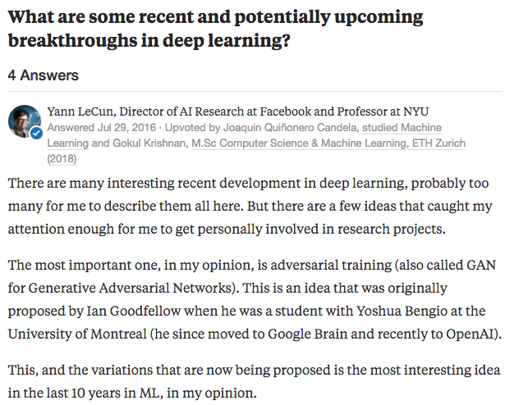
https://www.quora.com/What-are-some-recent-and-potentially-upcoming-breakthroughs-in-deep-learning

Slide 4
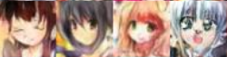
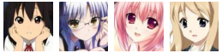
GAN Introduction
生成式對抗網路 Generative Adversarial Networks
Goodfellow, Ian, et al. "Generative adversarial nets." Advances in neural information processing systems. 2014.
生成器
Generator
Fake Image
鑑別器
Discriminator
誰是真的？
誰是假的？
Real Image

Slide 5
GAN Introduction
生成器
Generator
鑑別器
Discriminator
http://speech.ee.ntu.edu.tw/~tlkagk/courses/ML_2017/Lecture/GAN%20(v3).pdf

Slide 6
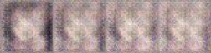
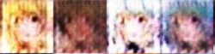
GAN Introduction
Generator V1
Generator V2
Generator V3
Fake Image: False
Fake Image: False
Fake Image: False
Discriminator V1
Discriminator V2
Discriminator V3
Real Image: True
http://speech.ee.ntu.edu.tw/~tlkagk/courses/ML_2017/Lecture/GAN%20(v3).pdf
https://zhuanlan.zhihu.com/p/24767059

Slide 7
Recap Autoencoder
Decoder 當做生成器
http://speech.ee.ntu.edu.tw/~tlkagk/courses/ML_2017/Lecture/GAN%20(v3).pdf
Notes:
但是亂給vector生圖會發生什麼事？

Slide 8
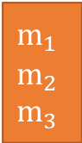
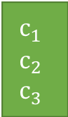
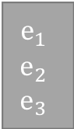
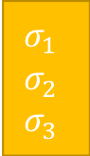
VAE
Variational Autoencoder
$$m_{1}$$
$$m_{2}$$
$$m_{3}$$
NN
Encoder
input
$$c_{1}$$
$$c_{2}$$
$$c_{3}$$
NN
Decoder
+
output
$$σ_{1}$$
$$σ_{2}$$
$$σ_{3}$$
exp
X
$$e_{1}$$
$$e_{2}$$
$$e_{3}$$
From a normal
distribution
http://speech.ee.ntu.edu.tw/~tlkagk/courses/ML_2017/Lecture/GAN%20(v3).pdf

Slide 9
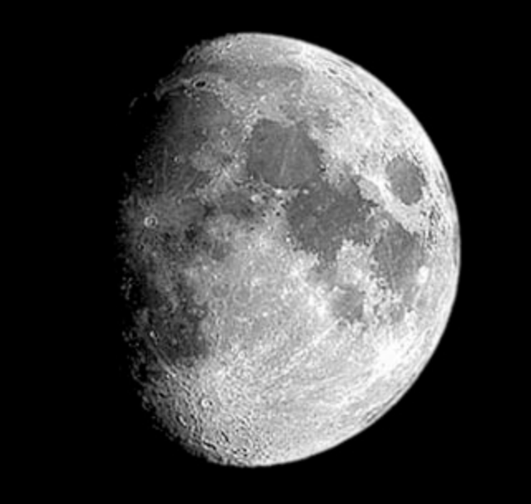
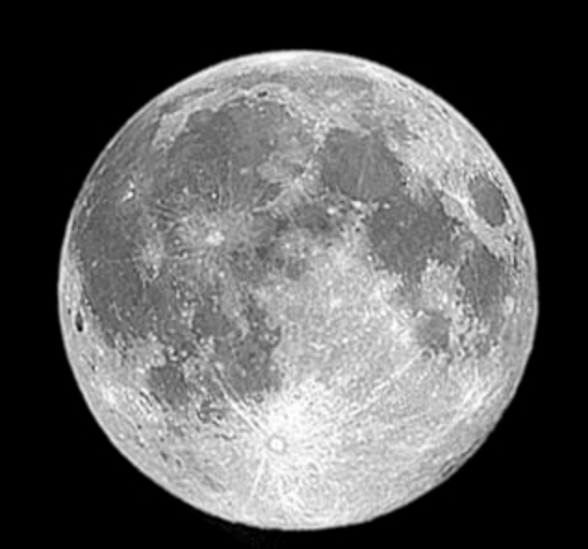
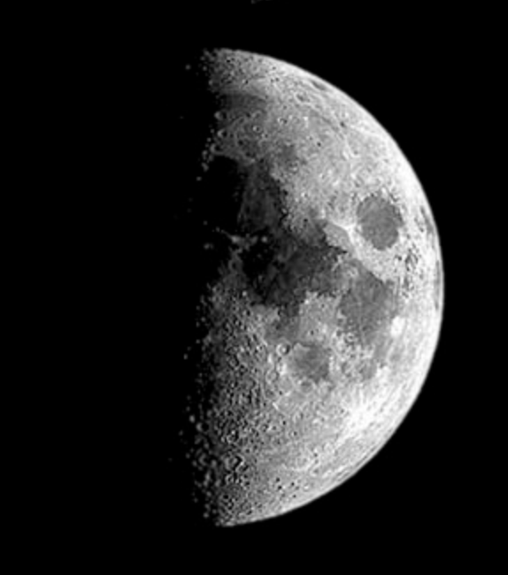
VAE
?
decode
decode
Code
Code
noise
encode
encode
http://speech.ee.ntu.edu.tw/~tlkagk/courses/ML_2017/Lecture/GAN%20(v3).pdf

Slide 10
VAE
Face manifold from conv/deconv variational autoencoder [Youtube]
Notes:
缺點 模糊
他只會模仿但不會創造
因為train的時候你是要他去學跟原本一樣的圖

Slide 11
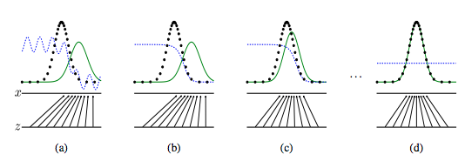
GAN
黑線：Real
綠線：Generator
藍線：Discriminator
Goodfellow, Ian, et al. "Generative adversarial nets." Advances in neural information processing systems. 2014.

Slide 12
GAN & DCGAN
Code
1_gan
2_dcgan
缺點
圖片品質不穩定
不知道什麼時候該停止

Slide 13
WGAN
3_wgan
Solve
解決 GAN 訓練不穩定的問題
解決 collapse mode
Wasserstein estimate 評估生成圖像品質
How
Discriminator 去掉 sigmoid
Generator, Discriminator loss 不取 log
不使用基於動量的 optimization function，改用 RMSProp

Slide 14
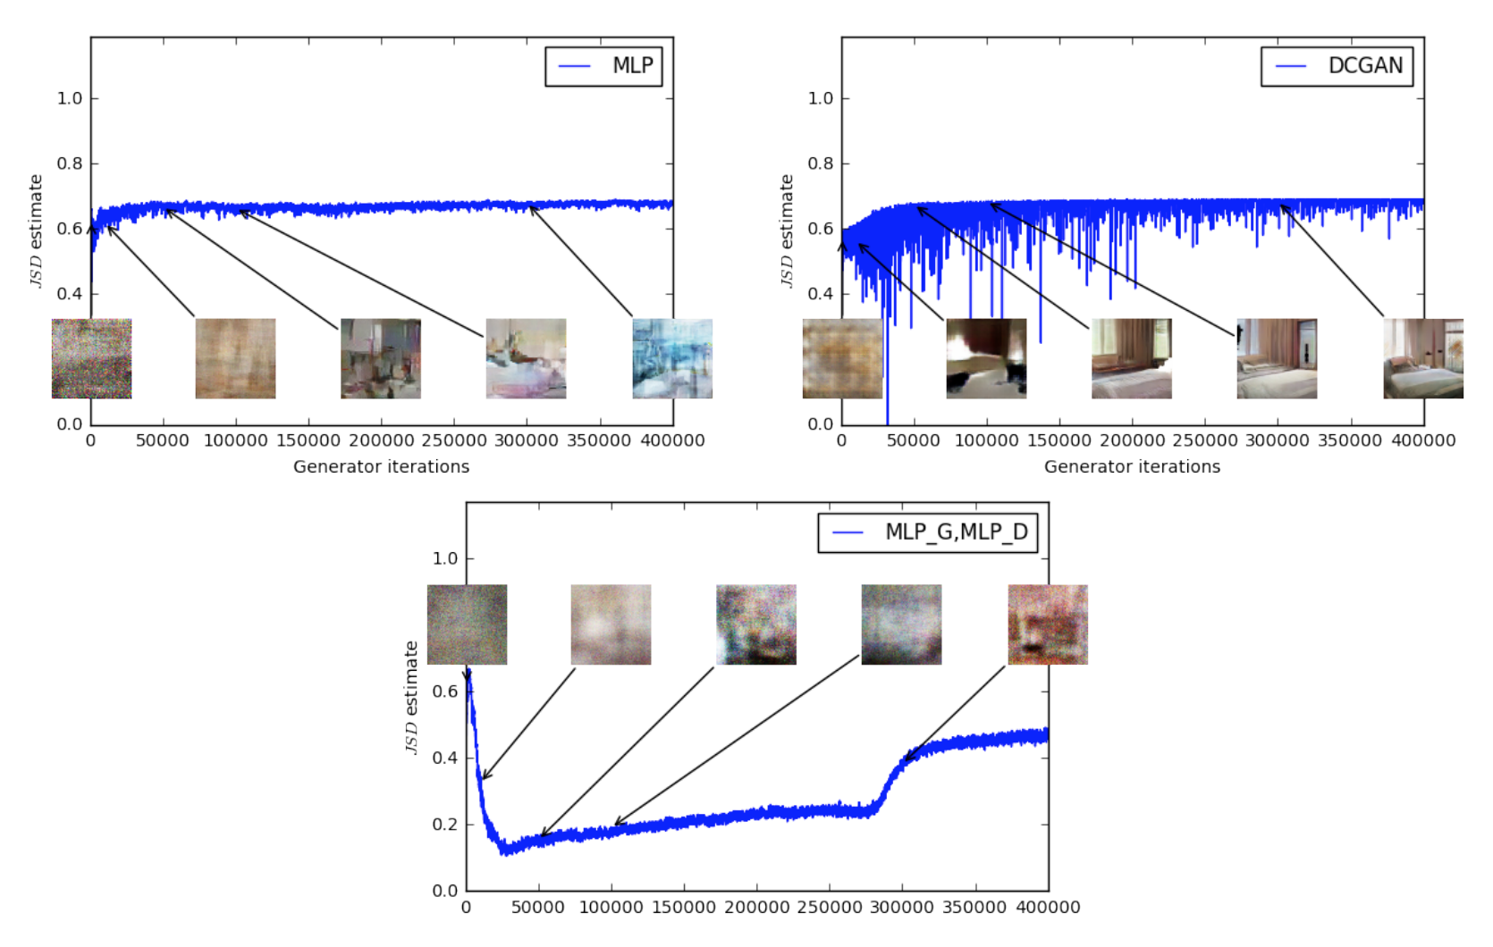
WGAN
Arjovsky, Martin, Soumith Chintala, and Léon Bottou. "Wasserstein gan." arXiv preprint arXiv:1701.07875 (2017).

Slide 15
WGAN
Arjovsky, Martin, Soumith Chintala, and Léon Bottou. "Wasserstein gan." arXiv preprint arXiv:1701.07875 (2017).

Slide 16
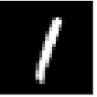


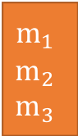
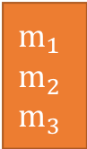
Conditional GAN
4_cgan
Fake Image
$$m_{1}$$
$$m_{2}$$
$$m_{3}$$
Generator
Discriminator
$$m_{1}$$
$$m_{2}$$
$$m_{3}$$
(1, 0, 0…..)
(0, 1, 0…..)
(0, 0, 1…..)

Slide 17
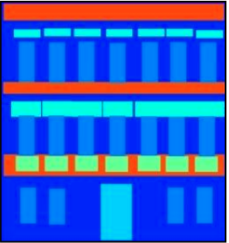
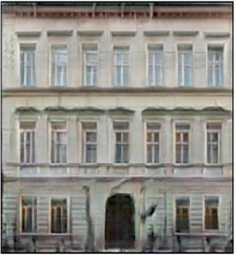
Pix2Pix
Pix2Pix
Image-to-Image Demo
Generator
Discriminator

Slide 18
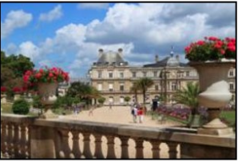
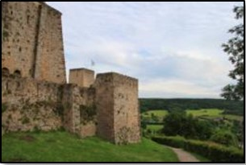
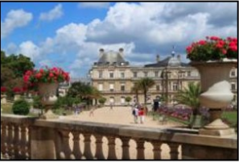
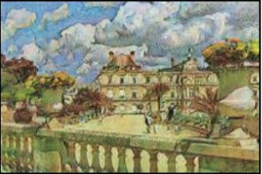
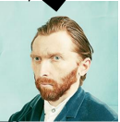
Cycle GAN
Domain X
Domain Y
Generator
X->Y
Generator
Y->X
Discriminator
IS Y?
Discriminator
IS X?
Generator
Y->X
Generator
X->Y
https://github.com/junyanz/CycleGAN
Notes:
風格轉換
Unpaired data

Slide 19
Reference
李宏毅 GAN Lecture 1: Introduction of GAN
李宏毅 ML Lecture 18: Unsupervised Learning - Deep Generative Model (Part II)
資料科學年會 一日搞懂生成式對抗網路
生成对抗网络（GANs）最新家谱
令人拍案叫绝的Wasserstein GAN
The GAN Zoo
Keras-GAN

